Slide 1
Agentless Introspection of Bare Metals
Demo - 5

Slide 2
What we have done? (Current sprint)
Understood BMI Components (CLI > Picasso > einstein)
Introduced “introspect” command in BMI CLI to implement end to end agentless introspection system.

Slide 3
BMI Components modified
BMI services are based on MVC framework.
Einstein module communicates with Ceph and perform operations.
CLI exposes the BMI API calls to the user.
Picasso is the REST API for BMI.
For implementing the ‘introspect’ command :
Made use of ‘snap’ function of BMI
Implemented Mapping and unmapping of specific image
Implemented Mounting and unmounting an image
Integrated Crawler with BMI
Integrated our Vulnerability Detection script with BMI

Slide 4
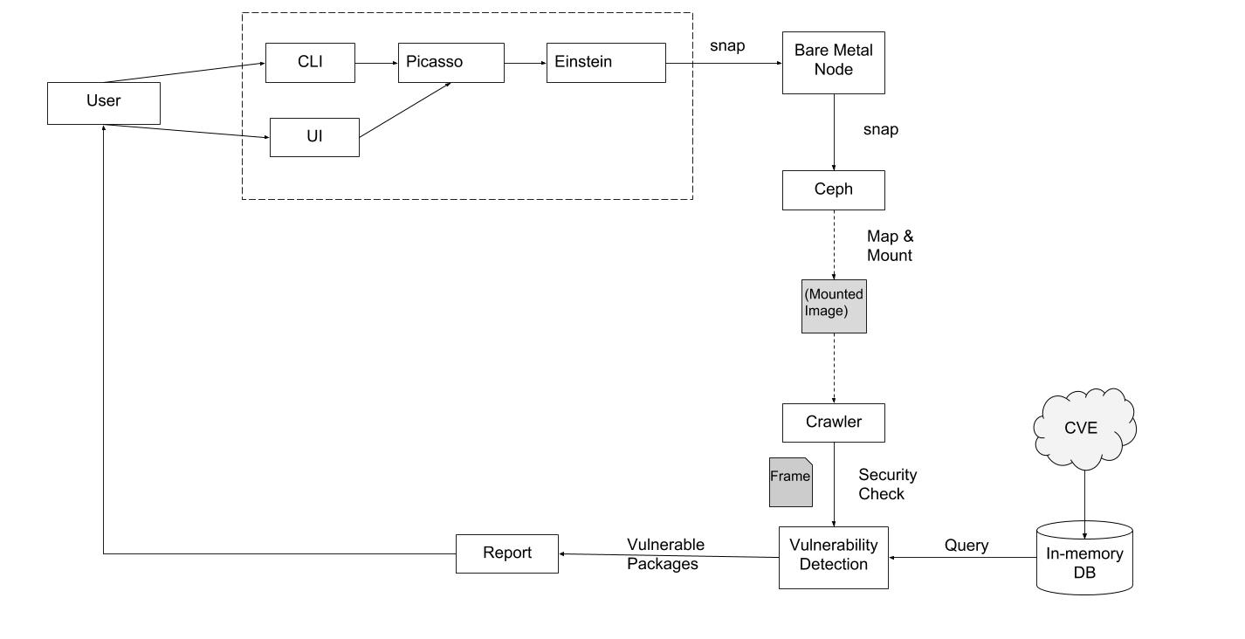
Workflow

Slide 5
Demo

Slide 6
Challenges
Accessing BMI due to IP and port based filtering
Provisioning a node
Discrepancy in BMI and Ceph - 1.Snapshot Already exists 2. Node Busy(could have clones) 3.snapshot not found
Notes:
Tftpboot Pxelinux .200 vlan

Slide 7
Plan for Next Sprint
Performance Analysis of deep snapshot as well as light snapshot
Connect User Interface to BMI API
Testing (create test cases for our system)

Slide 8
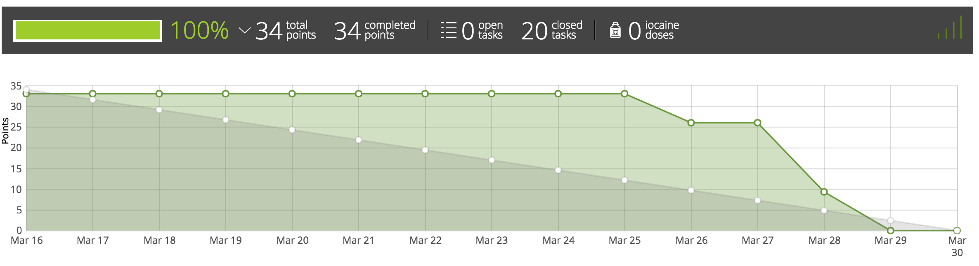
BurnDown Chart

